Slide 1
INTRODUCTION

Slide 2
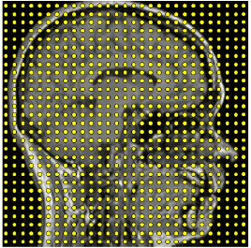
Basic Terms in DIP
Image: Image is defined as a 2-dimensional function f(x,y)
f(x,y)

Slide 3
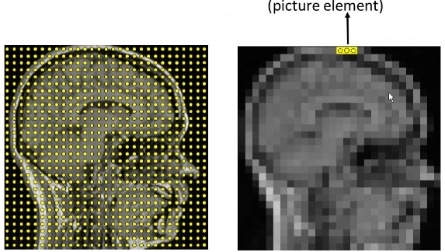
Digital Image: The image is called a digital image when x, y and intensity values of ‘f’ are finite and discrete.
Pixel: Digital image is composed of finite number of elements called pixels, each of which has a particular location and value

Slide 4
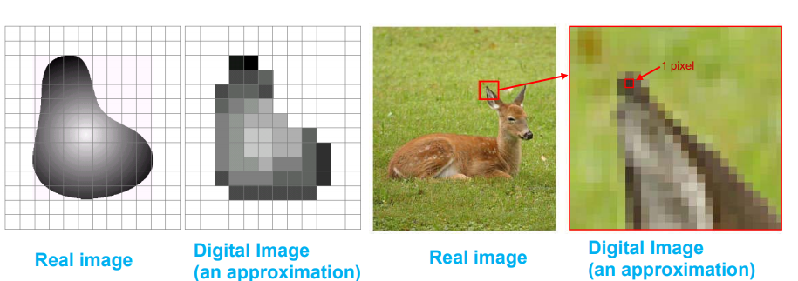

Slide 5


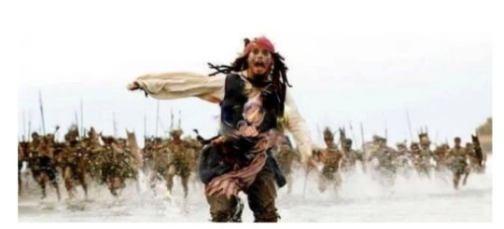
Digital Image Processing: Processing of digital image to......

Slide 6
Image Processing Steps

Slide 7
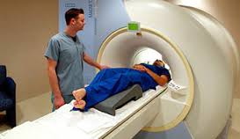
Image acquisition

Slide 8
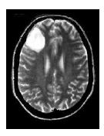
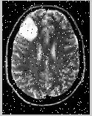
Image Enhancement
Filtered image

Slide 9
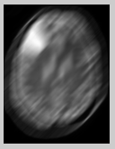
Image Restoration
restored image

Slide 10
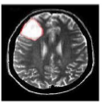
Segmentation
segmented image

Slide 11
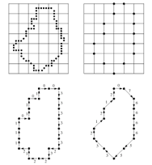
Representation and description

Slide 12
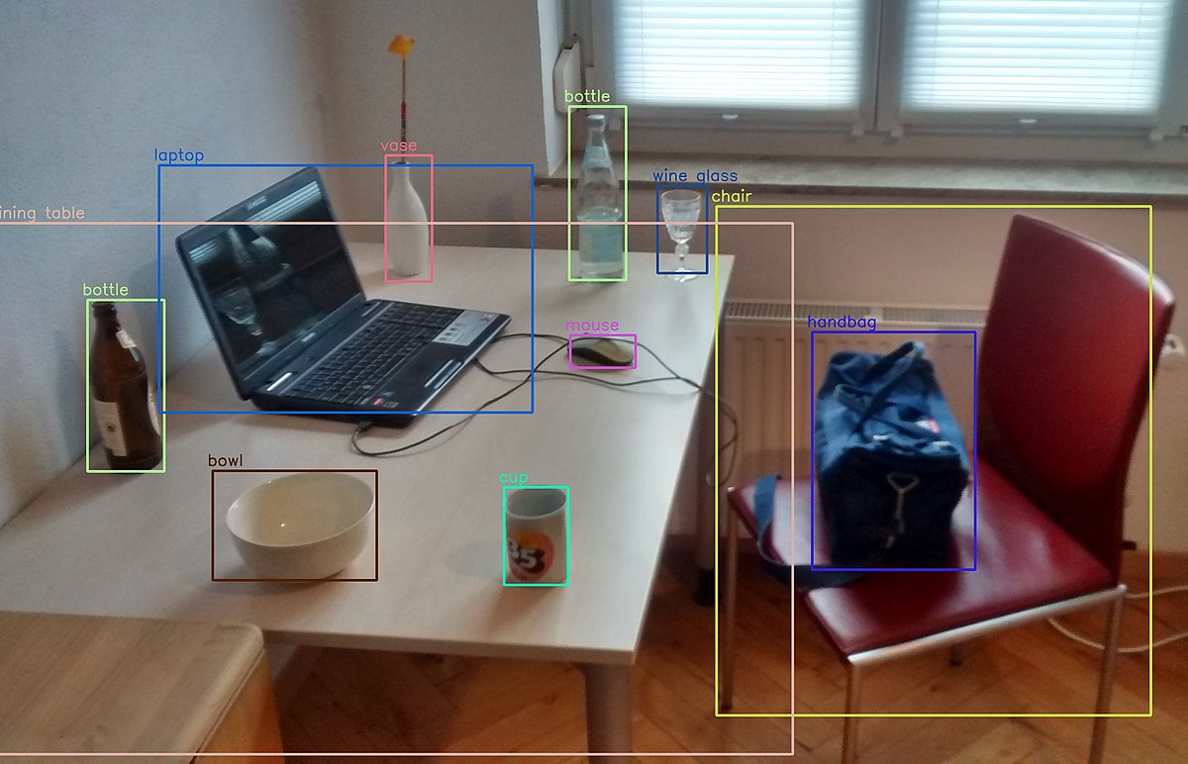
Object Recognition

Slide 13
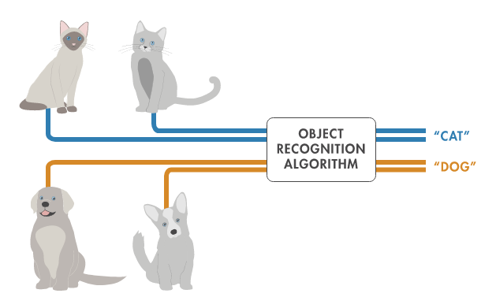

Slide 14
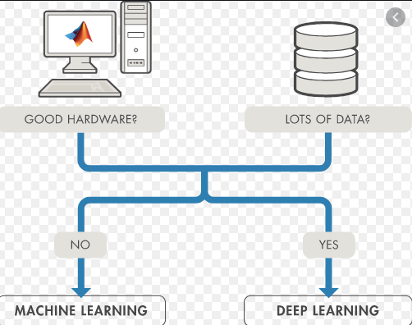

Slide 15
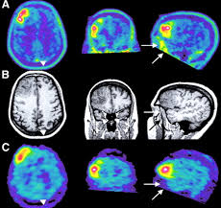
Color Image Processing

Slide 16
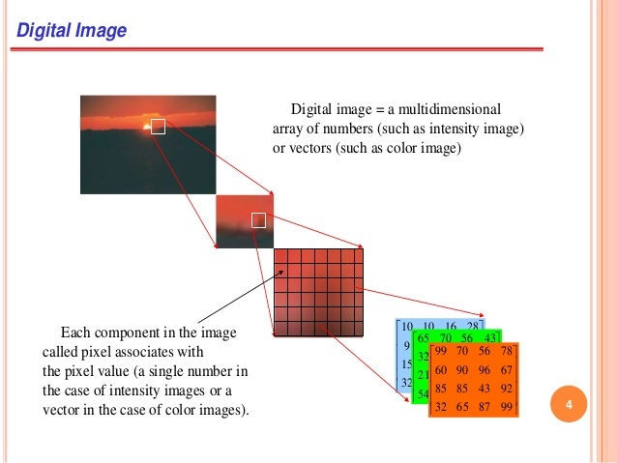

Slide 17
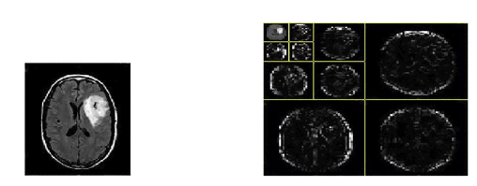
Wavelets & Multiresolution

Slide 18
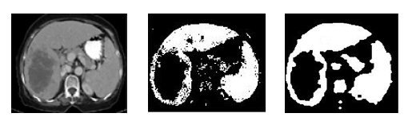
Morphological Processing

